Slide 1
Supply Chain Risk Analytics
Data Mining Project
Andrew Lennon, Marques Johnson, Noah Bocanegra, Will Dobrzanski
BUAN 314
Descriptive Analytics
Dr. Levkoff
Fall 2025
1
Notes:
MJ

Slide 2
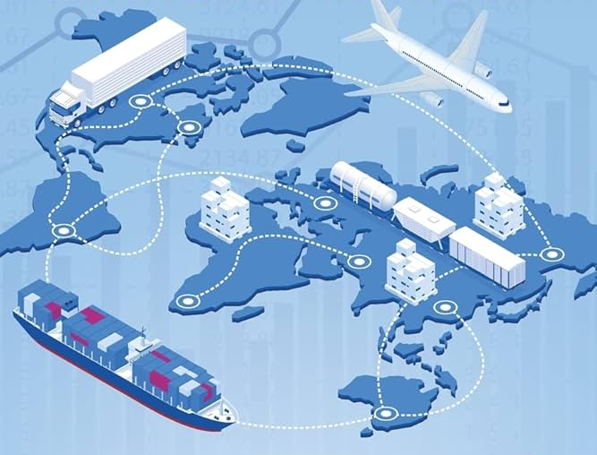
Contents
Executive Summary
Data Cleaning & Transformation
Descriptive Analysis
Queries
Visualizations
Linear Models
Conclusion
2
Notes:
MJ

Slide 3
Executive Summary
This report provides an exploratory analysis and evaluation of 1,000 real-world supply chain transactions across the United States (2023-2024), covering five major industries: Electronics, Machinery, Food, Pharmaceuticals, and Textiles.
Our data allows us to provide:
Comprehensive risk analysis with disruption tracking (weather, strikes, customs, shortages)
Supplier reliability scores and performance metrics
Multi-modal transportation data (rail, road, air, sea)
Order lifecycle from placement to delivery with delay analysis
Communication costs and energy consumption for sustainability research
3
Notes:
MJ

Slide 4
Data Cleaning and Transforming steps 1-2
Step One: Date Conversions
- Converted Order_Date, Dispatch_Date, Delivery_Date to Date type
- Created order_month and Order_Quarter for temporal analysis
Step Two: Created calculated fields for timing analysis
- Built new metrics to analyze where delays happen in the process
- Days_Until_Delivered: Total time from order to delivery
- Actual_Transit_Days: Time spent shipping
- Created On_Time_Flag as a binary indicator (1 = on time, 0 = delayed) from the Delay_Days field
supply_chain_df$Order_Date <- as.Date(supply_chain_df$Order_Date, format = "%Y-%m-%d")
supply_chain_df$Days_Until_Delivered <- as.numeric(Delivery_Date - Order_Date)
supply_chain_df$Order_Date <- as.Date(supply_chain_df$Order_Date, format = "%Y-%m-%d")
supply_chain_df$Actual_Transit_Days <- as.numeric(Delivery_Date -Dispatch_Date)
supply_chain_df$Order_Quarter <- quarters(supply_chain_df$Order_Date)
supply_chain_df$On_Time_Flag <- ifelse(Delay_Days == 0, 1, 0)
4
Notes:
MJ

Slide 5
Data Cleaning and Transforming steps 3-4
Step Three: Factor Conversions
- Converted categorical variables to factors for proper grouping
- Disruption_Severity ordered logically (None → Low → Medium → High)
- Enables accurate visualizations and statistical analysis
Step Four: Splitting into dimensional tables
- Split flat file into 3 relational tables
- order_df: Order_ID as primary key
- supplier_df: Supplier_ID as primary key
- buyer_df: Buyer_ID as primary key
- Enables SQL joins and eliminates data redundancy
supply_chain_df$Product_Category <- as.factor(supply_chain_df$Product_Category)
order_df <- supply_chain_df[, c("Order_ID", "Buyer_ID", "Supplier_ID", "Product_Category", "Quantity_Ordered"...)]
supply_chain_df$Shipping_Mode <- as.factor(supply_chain_df$Shipping_Mode)
supplier_df <- supply_chain_df %>% select(Supplier_ID, Supplier_Reliability_Score, Historical_Disruption_Count...)
supply_chain_df$Disruption_Severity <- factor(supply_chain_df$Disruption_Severity, levels = c("None", "Low", "Medium", "High"))
buyer_df <- supply_chain_df %>% select(Buyer_ID, Organization_ID, Dominant_Buyer_Flag)
5
Notes:
MJ

Slide 6
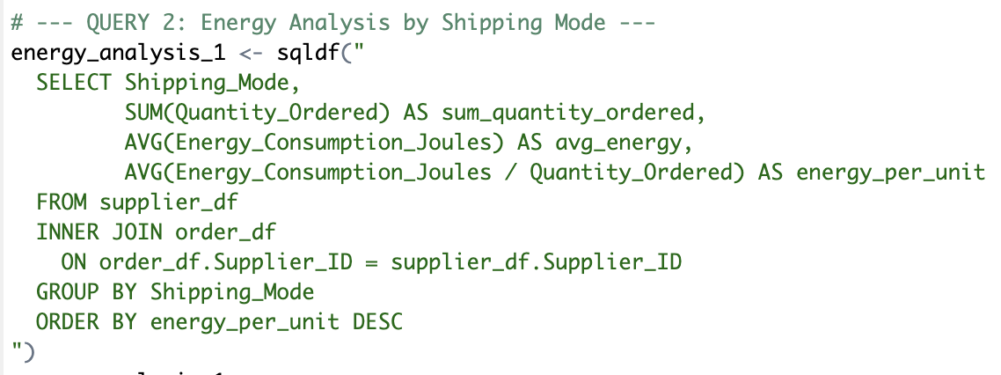
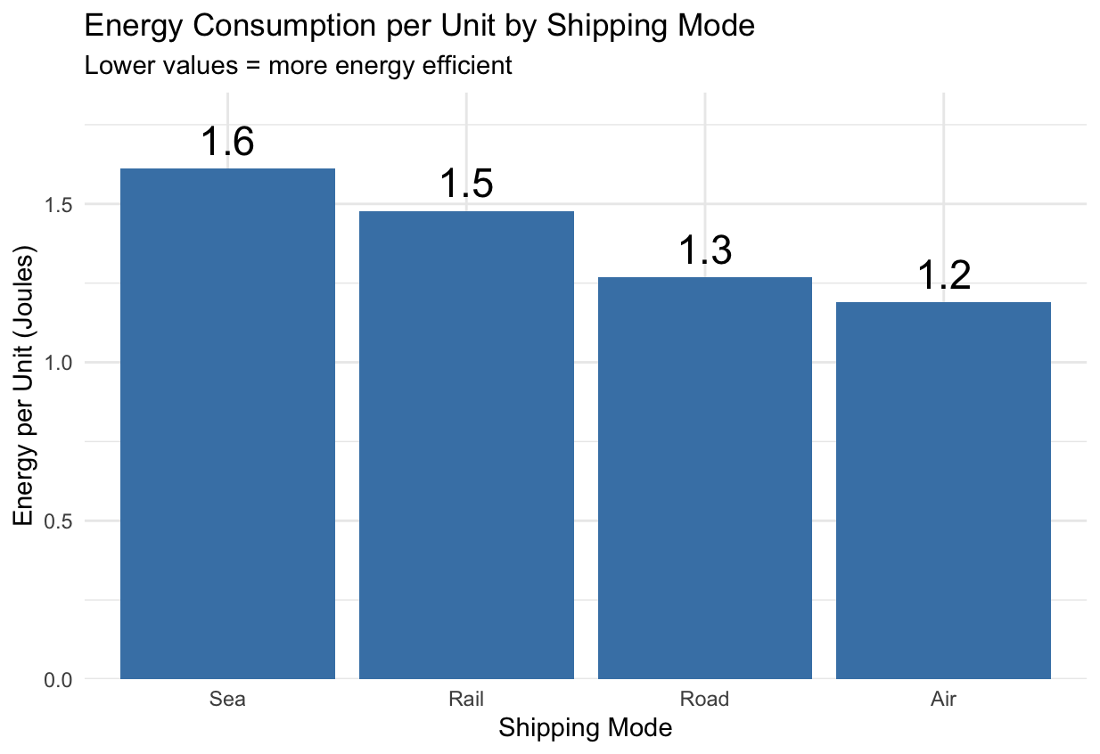
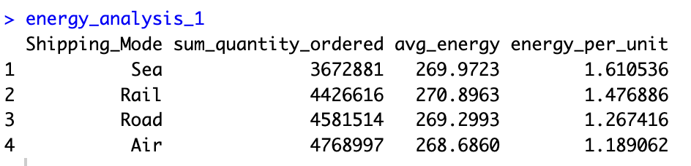
One of the first queries we ran to see how much energy is consumed per mode of transportation
Key Finding:
Air shipping is MOST energy-efficient at 1.2 J/unit
25% more efficient than Sea freight (1.6 J/unit)
Surprising finding: Air uses less energy per unit than slower modes
Possible factors: Reduced transit time, fewer handling steps, less warehousing
Energy Consumption per Unit by Shipping Mode
6
Notes:
Will
1.6 - 1.2 = 0.4
0.4 / 1.6 = 0.25 = 25%

Slide 7
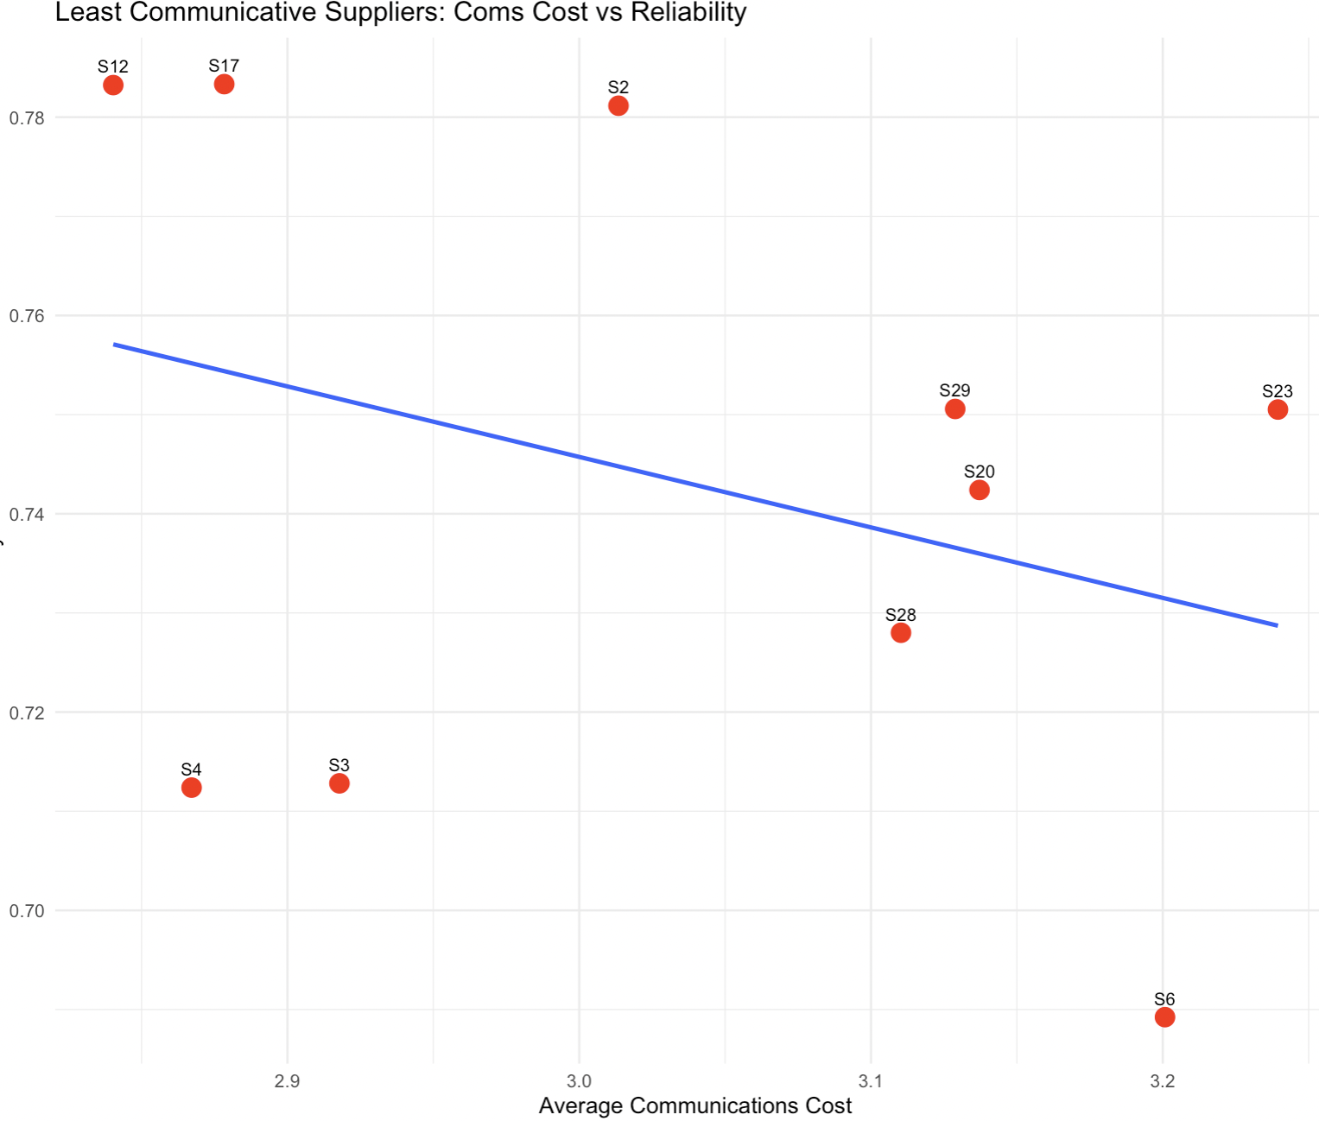
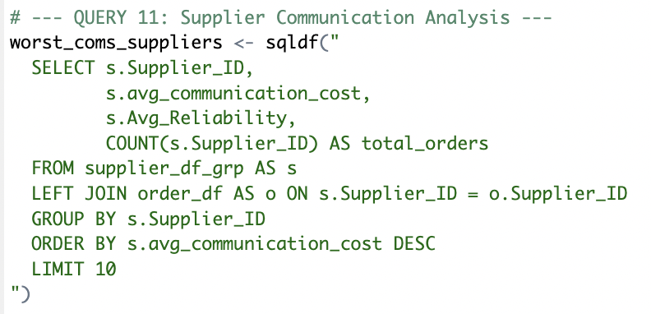
Key Finding:
Downward trend visible but NOT statistically significant
Linear model: R² = 0.10, p = 0.37
Communication costs do NOT predict supplier reliability
This led us to question: “what factors actually drive the reliability?”
Linear Model: lm(Avg_Reliability~ avg_communication_cost)
Communication Cost vs Reliability
7
Notes:
Will

Slide 8
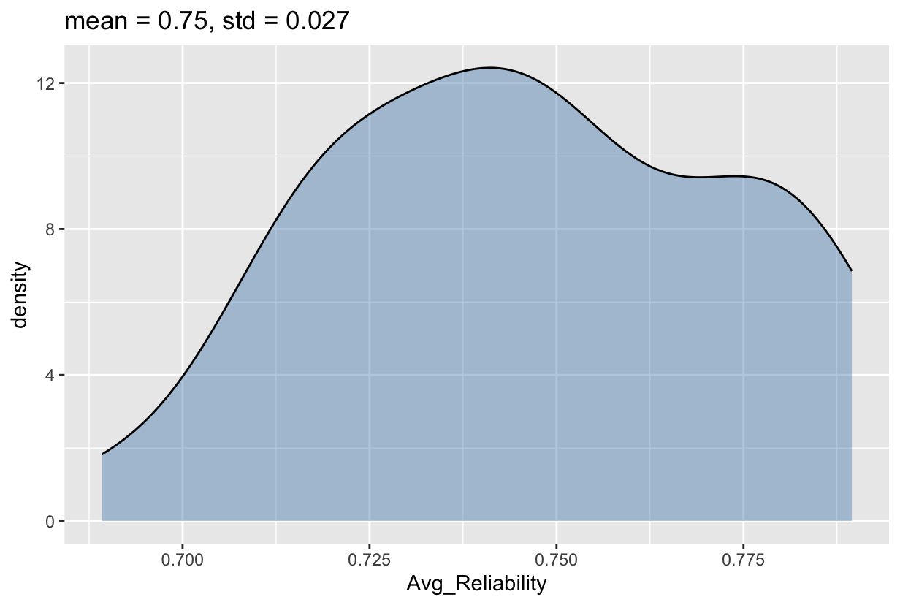
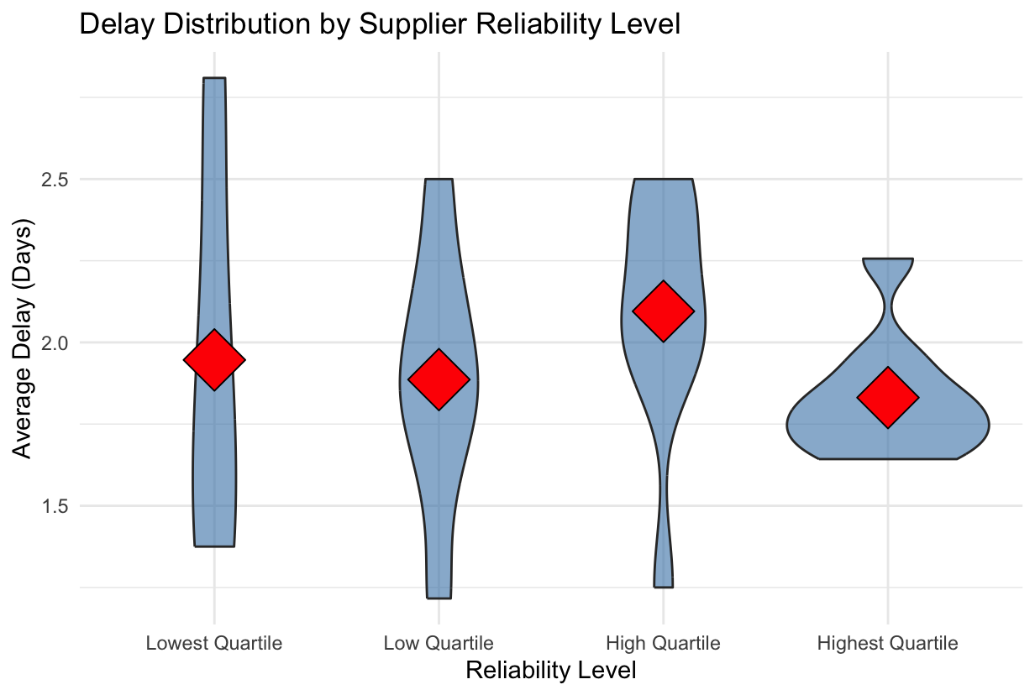
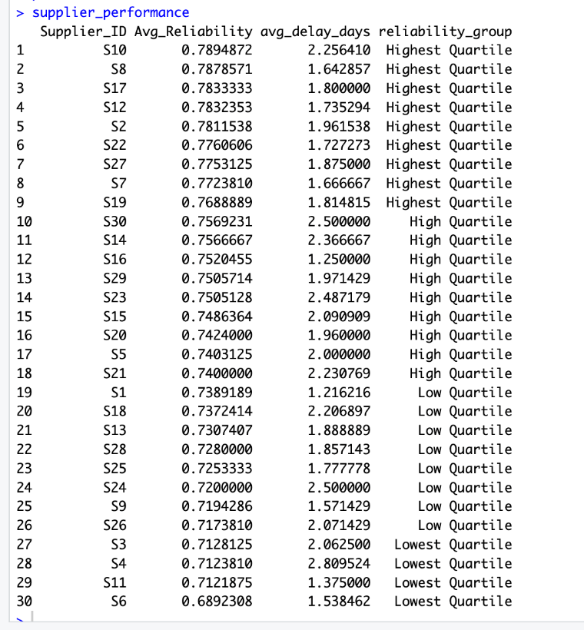
Reliability Score vs Actual Delays
8
Notes:
Key Finding:
All 5 reliability tiers show nearly identical delay distributions
"Highest reliability" (0.9-1.0) performs the same as "Lowest" (0.5-0.6) - Reliability score does NOT predict actual performance
Conclusion: Pre-calculated reliability scores are meaningless - focus on actual outcomes (delays, disruptions)
Most likely subjective rating from the Buyer
Queried the data to find the average reliability score and average delay days for each supplier
grouped reliability score into 4 quartiles
Tight distribution of reliability score likely hints that reliablity is a subjective rating
Not very useful as predictor or driver
Violin plot shows that

Slide 9
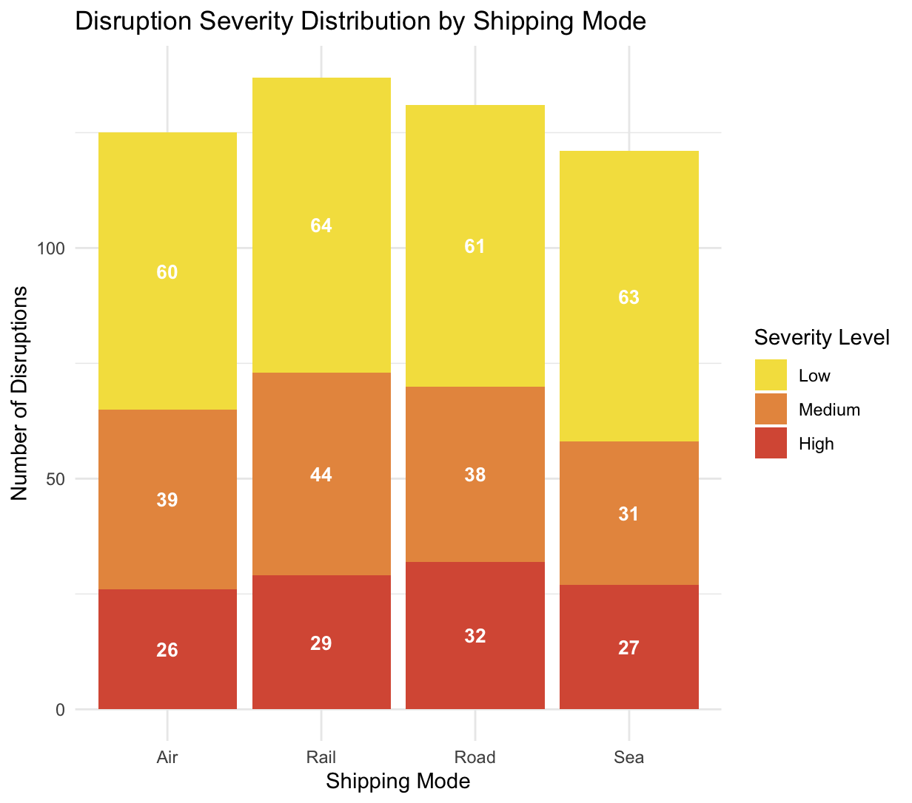
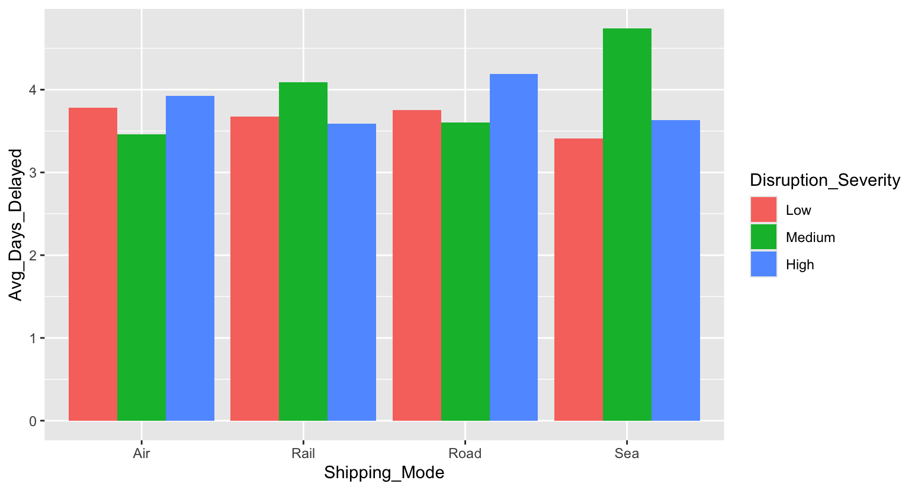
Key Findings:
All modes show similar total disruption counts (~125 each)
Low severity most common across all modes (60-64 disruptions)
Severity classification based on disruption type, not delay length
Business Insight: Focus on preventing disruptions entirely rather than worrying about severity levels
Disruption Severity by Shipping Mode
9
Notes:
Queried data to find sums of disruption severity across shipping mode
Used col geometry with stack position
We found that low severity is the most common
We also took the averages of each severity did not find significant differences in delay length
Business Insight: prevent delays altogether, disregard concern about severity

Slide 10
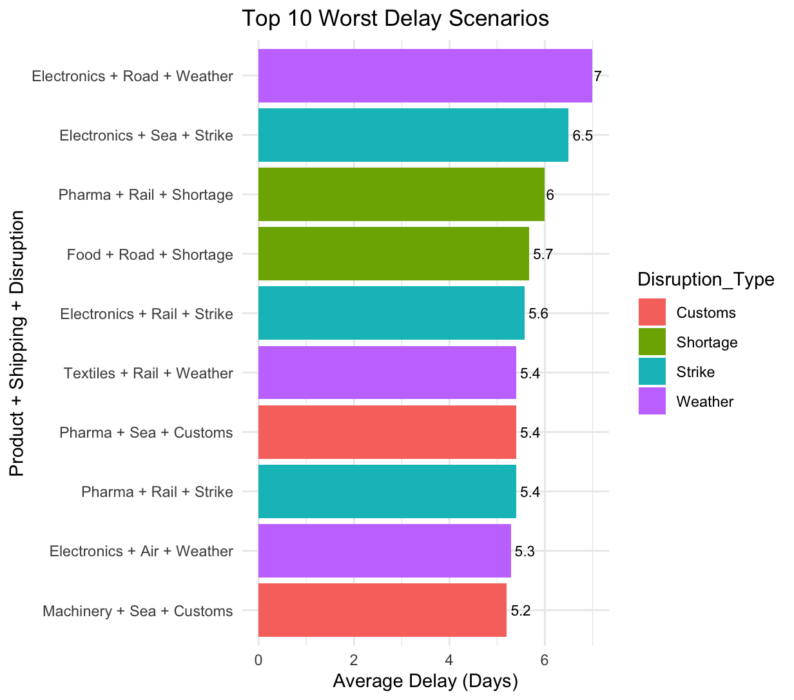
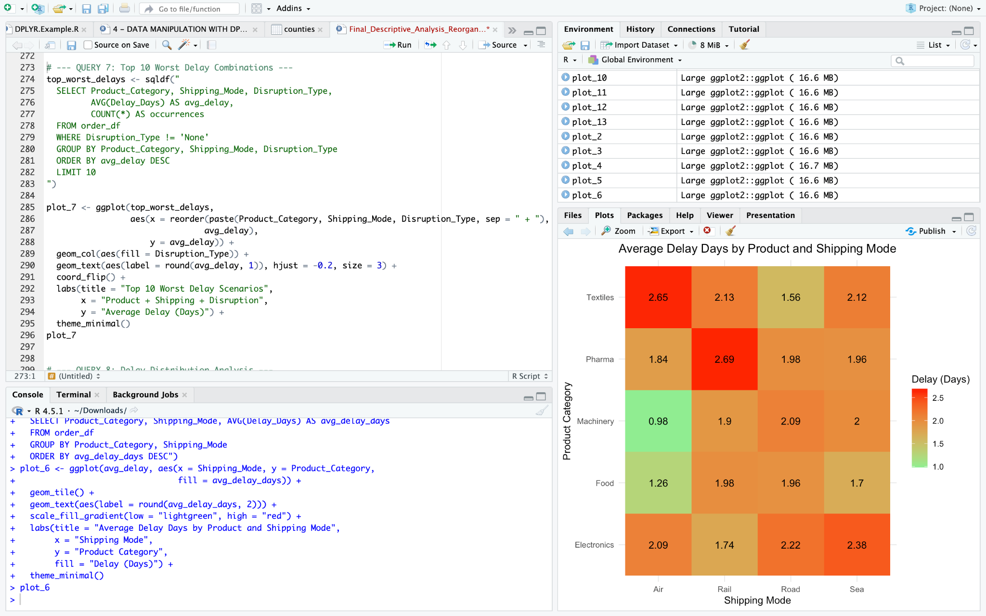
Key Findings:
Electronics + Road + Weather causes longest delays (7 days)
Weather disruptions dominate top scenarios (purple bars)
Electronics appears in 4 of top 10 worst combinations
Shortage disruptions consistently cause 5.7-6 day delays
Strike disruptions affect both Sea and Rail modes (5.4-6.5 days)
Weather and shortage disruptions are the highest-impact events - require contingency planning and alternative routing strategies
Top 10 Worst Delay Scenarios
10
Notes:
n
Weather disruptions dominate the top scenarios because they affect multiple transport modes

Slide 11
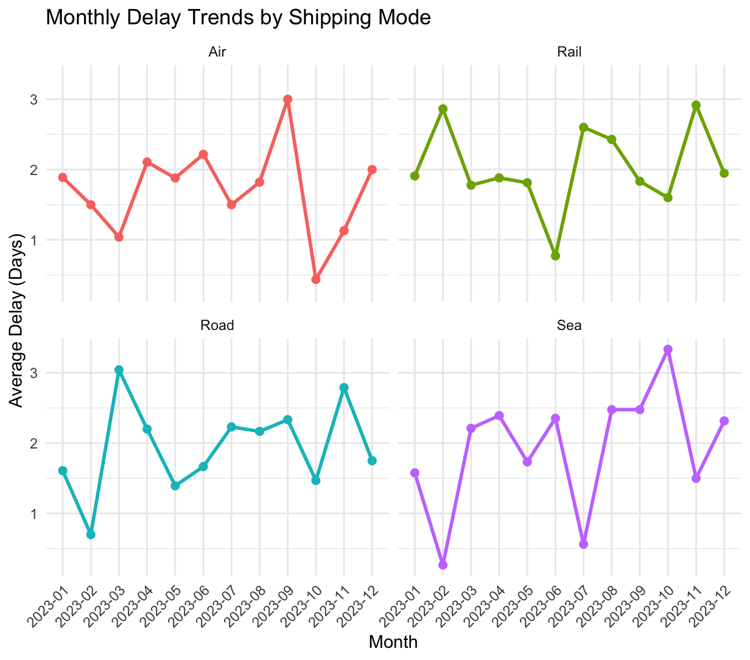
Monthly Delay Trends by Shipping Mode
Key Finding:
Sea freight most volatile: 0.27 to 3.33 days (3.06 day range)
Air most stable: 0.44 to 3.00 days (2.56 day range)
Sea volatility coincides with 2023 Panama Canal drought restrictions (Reuters, 2023) - NOT definite but a possible contributing factor
Business Insight: Be prepared for unforeseen circumstances - external events (weather, infrastructure) can cause sudden shipping delays. Build contingency plans and monitor global disruptions.
11
Notes:
n
https://www.reuters.com/world/americas/panama-canal-water-levels-historic-lows-restrictions-remain-2023-09-06/?utm_source=chatgpt.com

Slide 12
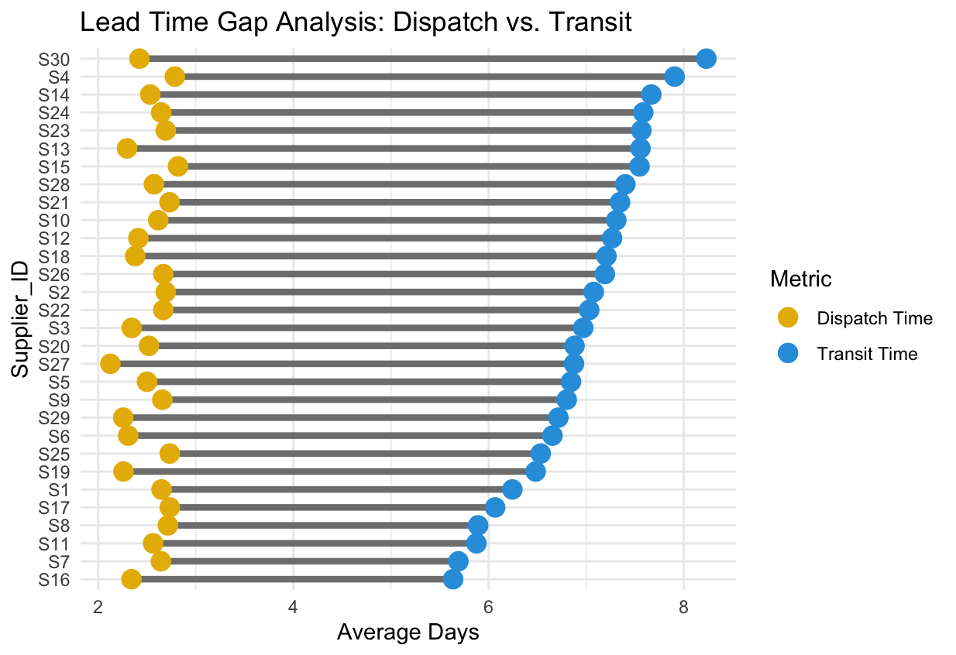
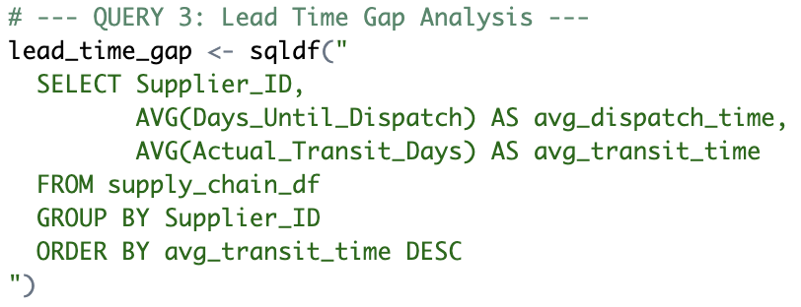
3 - Visually shows the “gap” between the two lead-time components for every Supplier_ID, ordered from the longest to shortest transit time
Key finding:
S16 fastest overall: 8.0 days total (2.3 dispatch + 5.6 transit)
S4 and S30 slowest: 10.6 days total (2.4 dispatch + 8.2 transit)
Dispatch time fairly consistent (2.1-2.8 days across all suppliers)
Transit time drives performance- (5.6-8.2 days)
Lead Time Gap Analysis
12
Notes:
Will
All suppliers process at similar speeds (about 2.5 days), but SHIPPING varies wildly. That's where the problem is

Slide 13
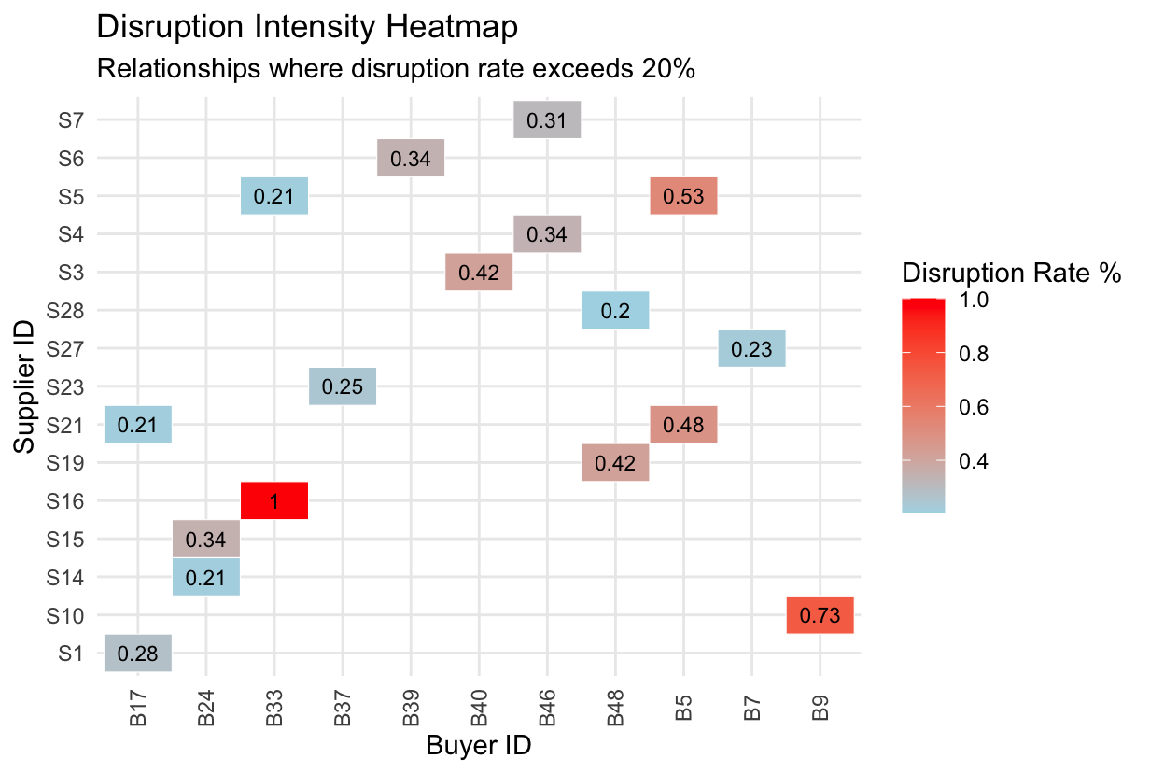
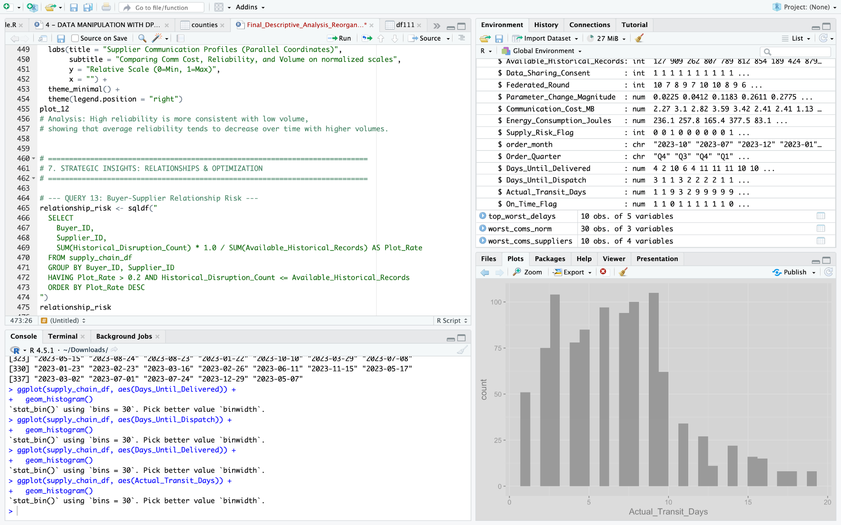
Disruption Heat Map
Key Finding:
17 buyer-supplier relationships with >20% disruption rate
3 HIGH RISK (>50%): S16-B33 (100%), S10-B9 (73%), S5-B5 (53%)
14 moderate risk (20-50%)
13
Notes:
Noah
Queried the data to find the disruption rate for each possible Supplier-Buyer Relationship
Used tile geometry and a gradient scale to display severity
Plots each

Slide 14

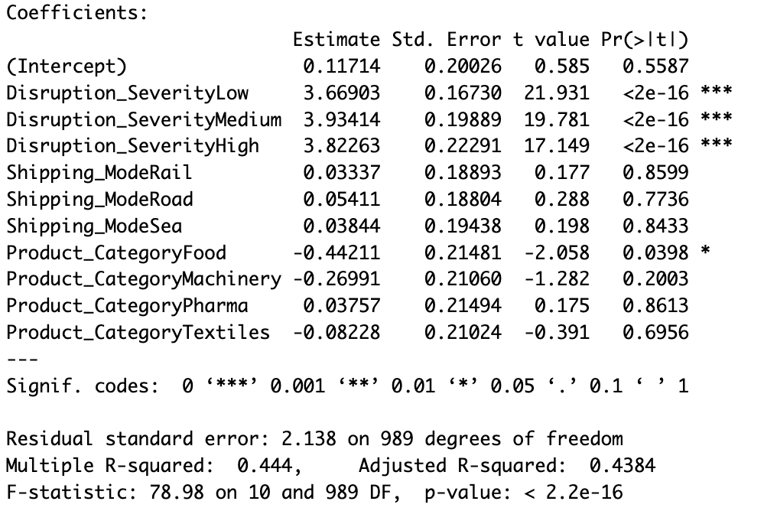
“model_1” : Linear Model
Key findings:
R^2 =.44(explains 44% of delay variance)
All disruption severities add 3.7-3.9 days of delay
Query 5: Severity reflects disruption type not delay length
Food products have 0.44 fewer delay days most likely due to perishability (coincidence with r^2)
Interpretation: Any disruption causes about 4 days of delay. Focus on prevention rather than severity management. Food receives preferential treatment to minimize spoilage
*p < 0.05 (significant)
14
Notes:
Andrew

Slide 15
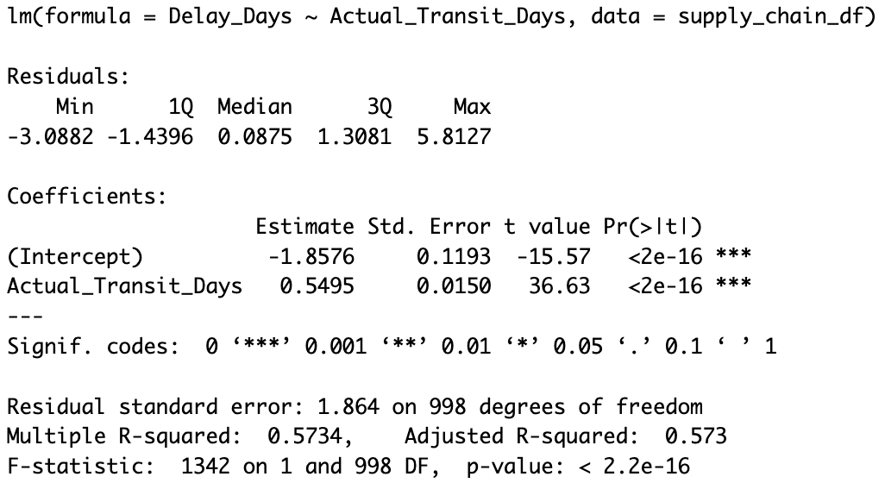
“model_2”: Linear Model
Transit Time vs Delays
Formula: Delay = -1.86 + 0.55x
Each additional transit day adds 0.55 delay days
Examples:
5-day transit: -1.86 + 0.55(5) = 0.89 days delay
10-day transit: -1.86 + 0.55(10) = 3.64 days delay
Difference:
10-day shipments have 2.75 more delay days than 5-day
R^2 = 57% - explains more variance than Model 1
P-Value < 2.2e-16 - relationship is highly statistically significant
15
Notes:
Will
Interpretation: Transit time is a stronger predictor than disruption severity. Longer shipping windows create more delay opportunities. Choose faster modes when delay risk matters.

Slide 16
Conclusion
Delays are Predictable and Preventable
Transit time can help predict disruption probability
Regression models can help buyers plan around delays
Multiple Strategic Opportunities exist for Buyers
Airshipping is 25% more energy efficient
Specific product-shipping combos create worsened delays
Buyers can visualize where Supplier Relationship Management needs improvement
Recommendations for the Future
Focus on reducing transit time rather than dispatch time
Create reliability scores based on quantitative Supplier Scorecards
Optimize product and shipping mode pairings
16
Notes:
MJ

Slide 17
Thank You!
178

Slide 18
Works Cited
Yuan Chunhong. US Supply Chain Risk Analysis Dataset. Kaggle,
https://www.kaggle.com/datasets/yuanchunhong/us-supply-chain-risk-analysis-dataset. Accessed 9 Dec. 2025.
Moreno, Elida. “Panama Canal Water Levels at Historic Lows, Restrictions to Remain.” Reuters, 6 Sept. 2023,
https://www.reuters.com/world/americas/panama-canal-water-levels-historic-lows-restrictions-remain-2023-09-06/. Accessed 9
Dec. 2025
18

Slide 19
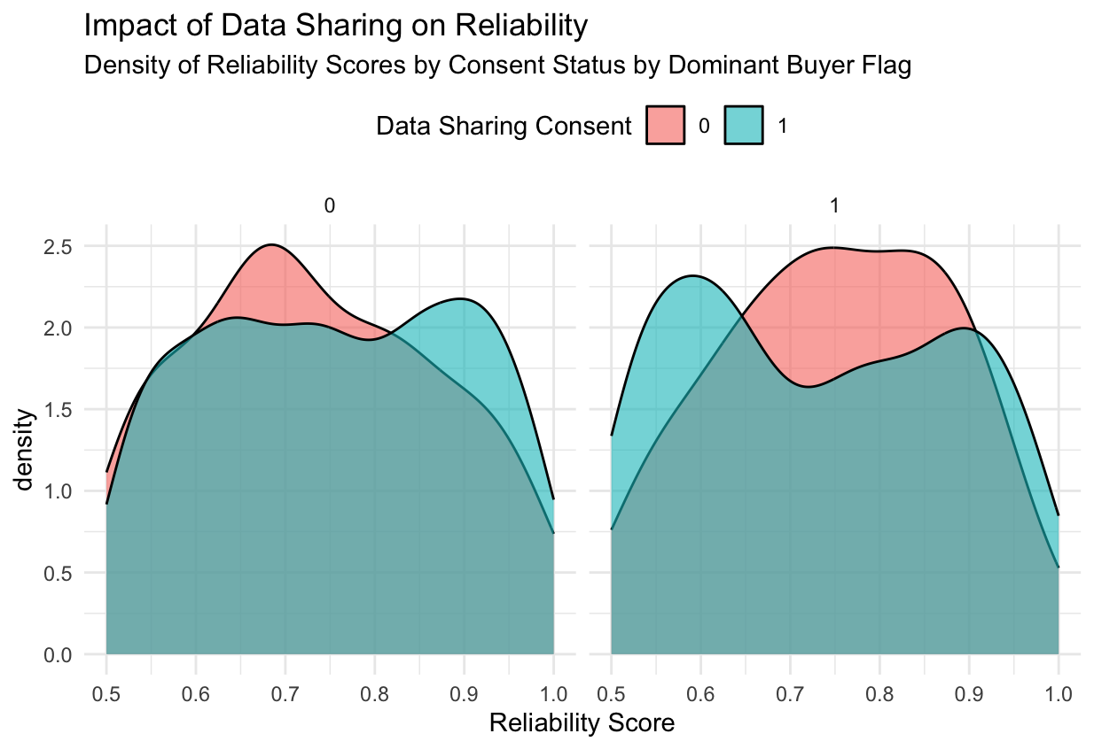
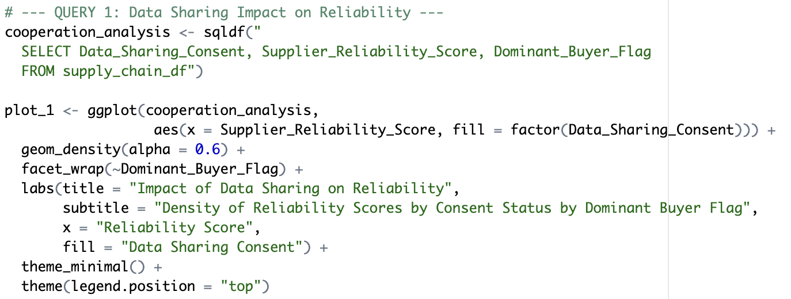
Visualization 1 and query 1

Slide 20
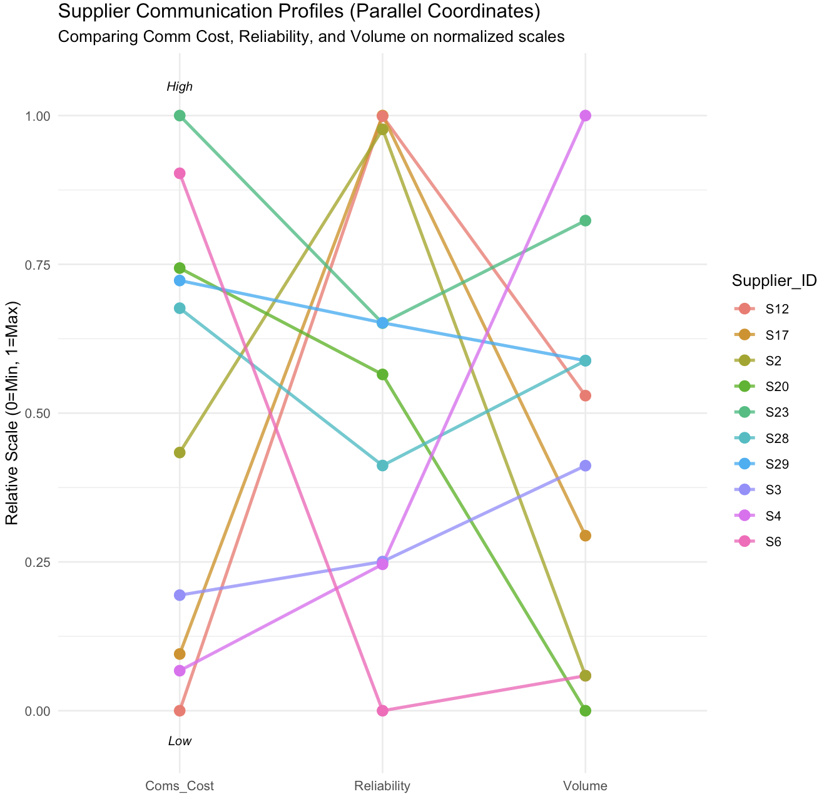
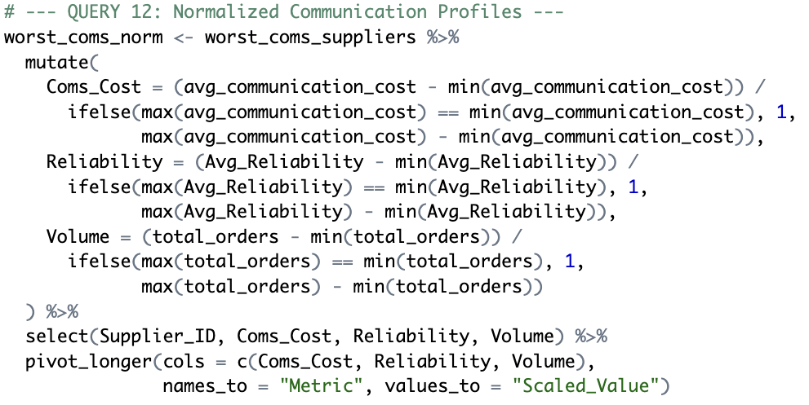
Supplier Comm. Profiles
Key findings:
Three metrics normalized to 0-1 scale for comparison
Notes:
Noah
This slide was #12/17 Think I might remove it because we already talked about reliability score being useless

Slide 21
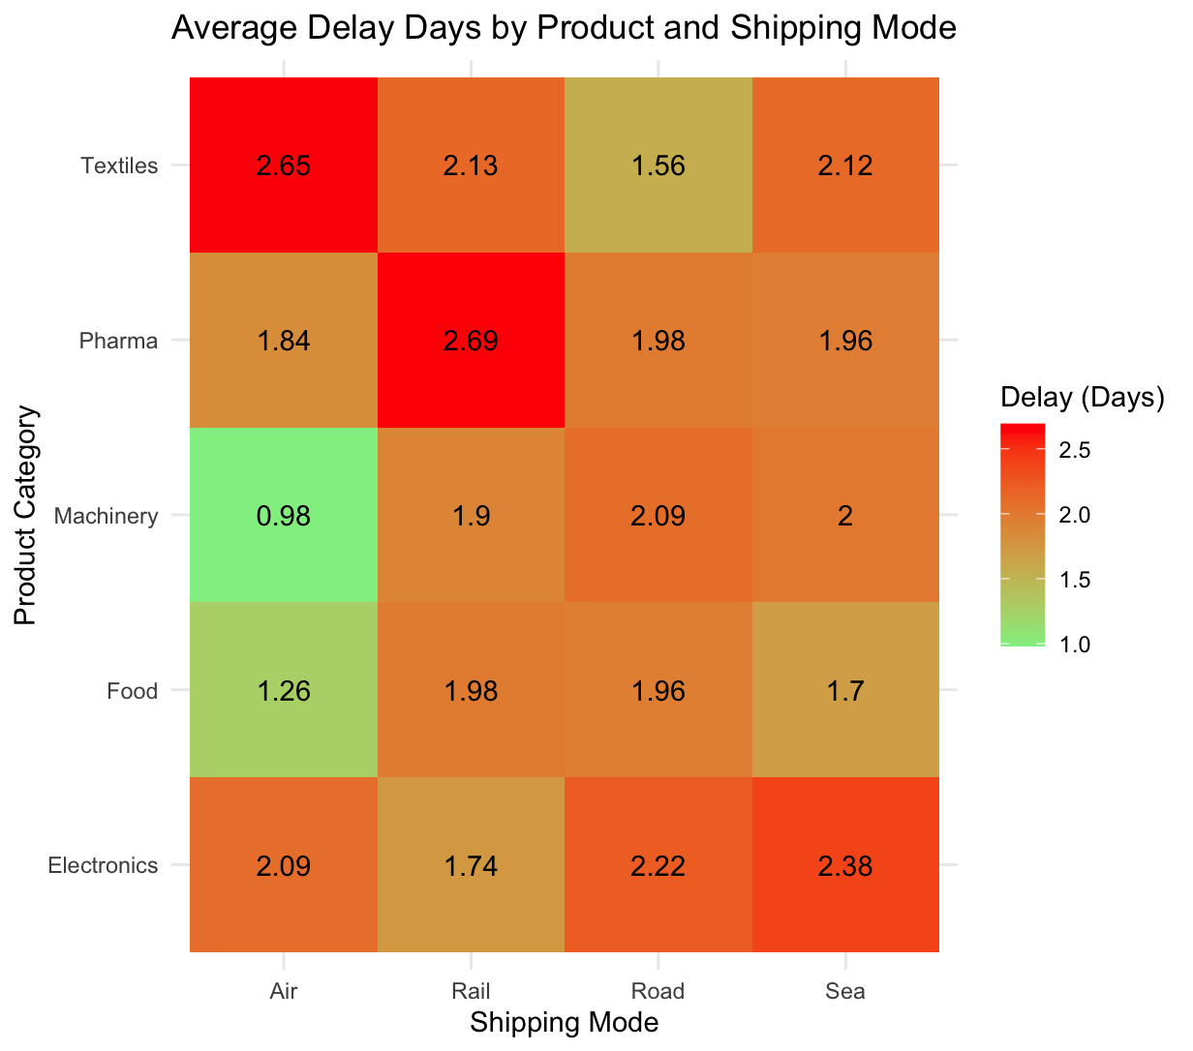
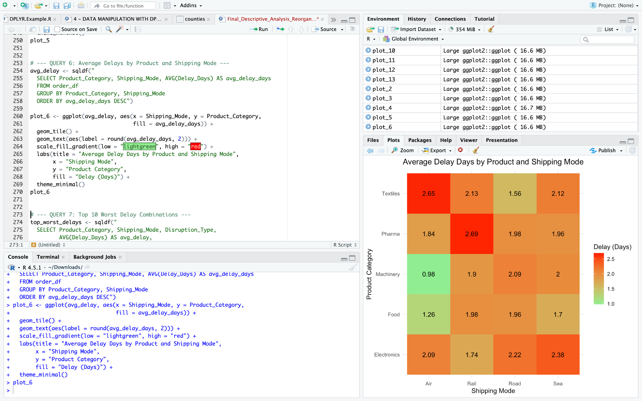
Visualization 6 and query 6

Slide 22
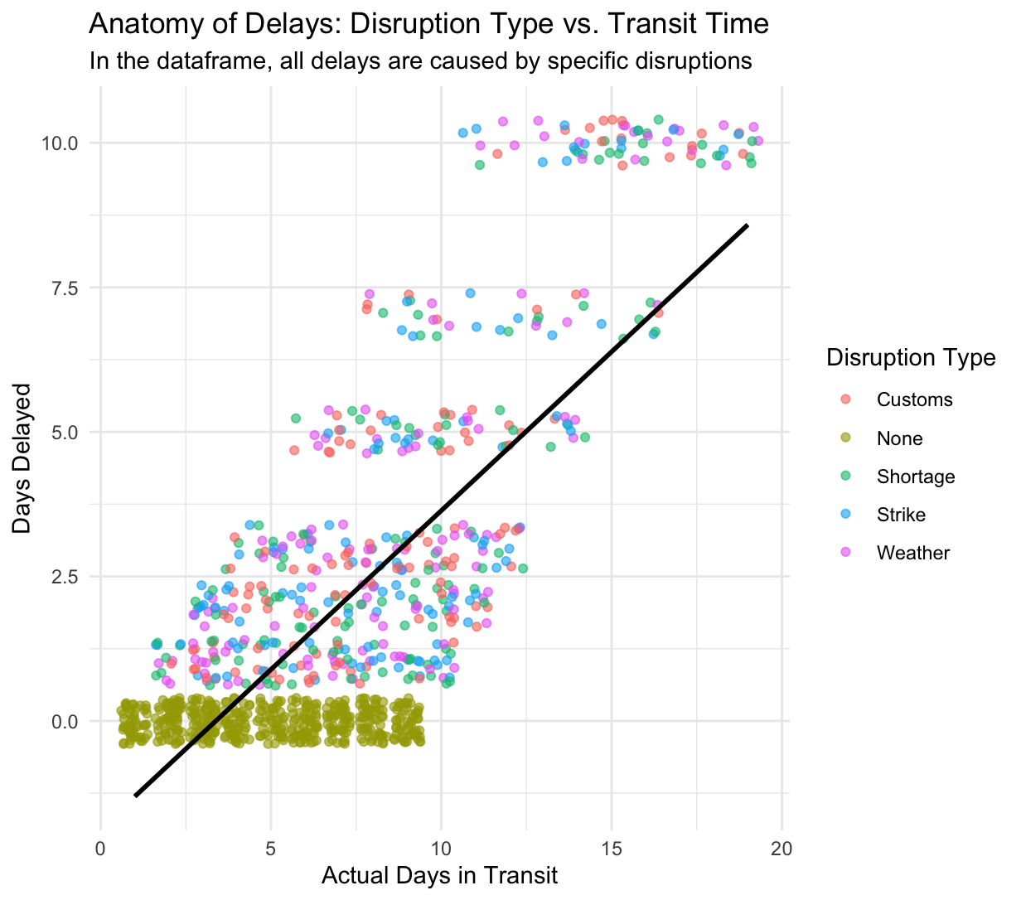
Visualization 8

Slide 23
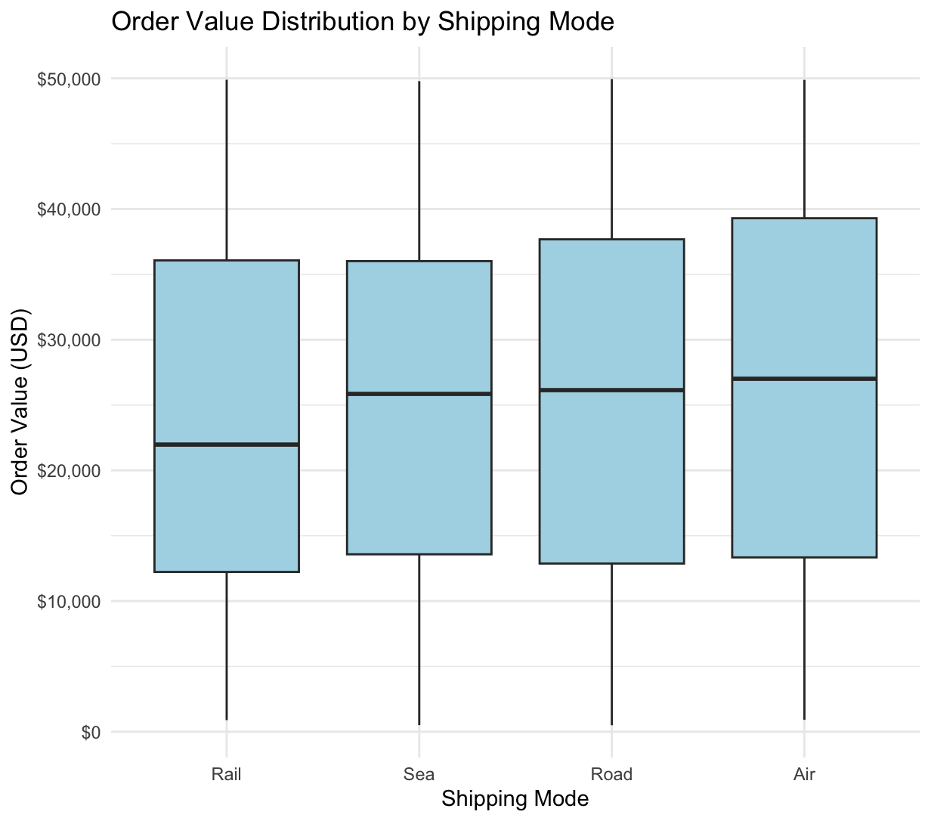
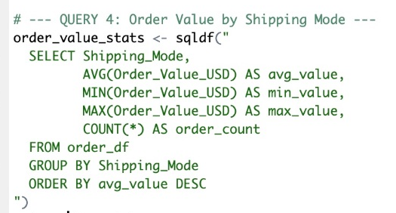
Visualization 4 and query 4

